Slide 1
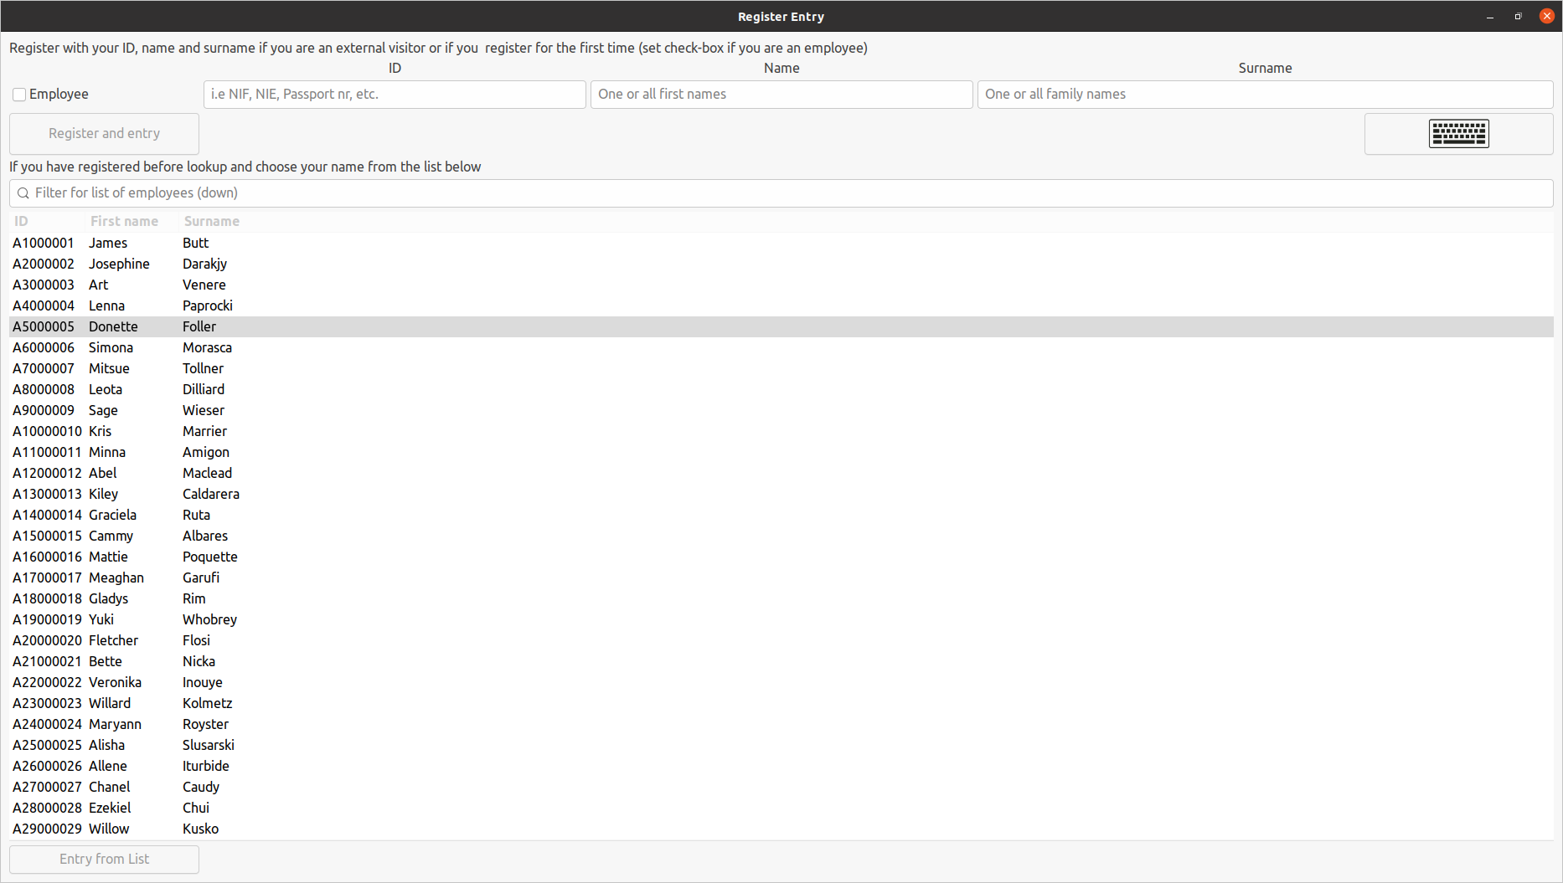
If you have never registered please do so by filling in your data (inc checkmark if you are an employee)
using the button “Register and Entry” to register. Use the button with the keyboard (⌨) to show the onscreen Keyboard.
After registering the first time as employee, your name will appear in this list, allowing you
to register the next time(s) with a single click on the button “Entry from List” or double clicking on your name.
Use the search bar to filter for your name or id.

